Slide 1
KIRCHOFF’UN VOLTAJ ve AKIM KANUNLARI - TEKRAR

Slide 2
Kirchoff’un Voltaj ve Akım Kanunlar - Tekrar

Slide 3
Kirchoff’s Voltage Law - KVL (Kirchoff’un Voltaj Kanunu)

Slide 4
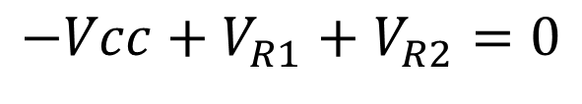
Kirchoff’s Voltage Law - KVL (Kirchoff’un Voltaj Kanunu)
$$−Vcc+V_{R1}+V_{R2}=0$$

Slide 5

Kirchoff’s Voltage Law - KVL (Kirchoff’un Voltaj Kanunu)
$$−Vcc+V_{R1}+V_{R2}=0$$
$$−V_{R2}+V_{R3}=0$$

Slide 6
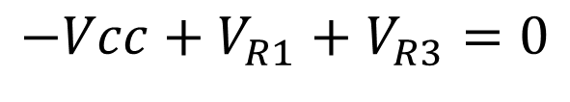

Kirchoff’s Voltage Law - KVL (Kirchoff’un Voltaj Kanunu)
$$−Vcc+V_{R1}+V_{R2}=0$$
$$−V_{R2}+V_{R3}=0$$
$$−Vcc+V_{R1}+V_{R3}=0$$

Slide 7
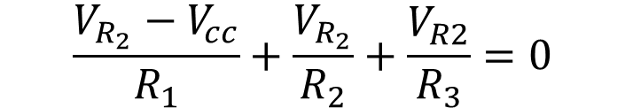
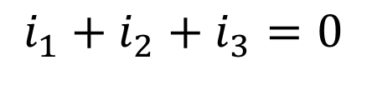
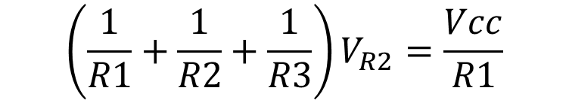
Kirchoff’s Current Law – KCL (Kirchoff’un akım kanunu)
$$i_{1}+i_{2}+i_{3}=0$$
$$\frac{V_{R_{2}}−V_{cc}}{R_{1}}+\frac{V_{R_{2}}}{R_{2}}+\frac{V_{R2}}{R_{3}}=0$$
$$\left(\frac{1}{R1}+\frac{1}{R2}+\frac{1}{R3}\right)V_{R2}=\frac{Vcc}{R1}$$

Slide 8

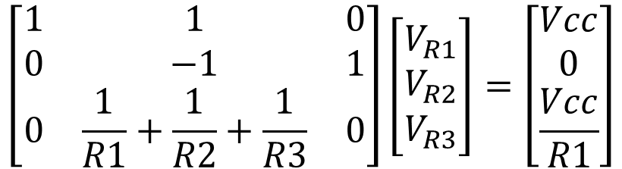
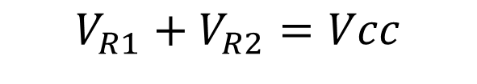

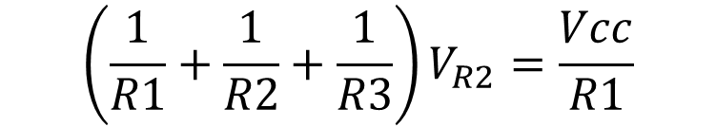



$$V_{R1}+V_{R2}=Vcc$$
$$−V_{R2}+V_{R3}=0$$
$$i_{1}+i_{2}+i_{3}=0$$
$$\left(\frac{1}{R1}+\frac{1}{R2}+\frac{1}{R3}\right)V_{R2}=\frac{Vcc}{R1}$$
$$\left[\begin{matrix}1 & 1 & 0 \\ 0 & −1 & 1 \\ 0 & \frac{1}{R1}+\frac{1}{R2}+\frac{1}{R3} & 0\end{matrix}\right]\left[\begin{matrix}V_{R1} \\ V_{R2} \\ V_{R3}\end{matrix}\right]=\left[\begin{matrix}Vcc \\ 0 \\ \frac{Vcc}{R1}\end{matrix}\right]$$
$$Ax=y$$
$$A^{−1}Ax=A^{−1}y$$
$$x=A^{−1}y$$

Slide 9





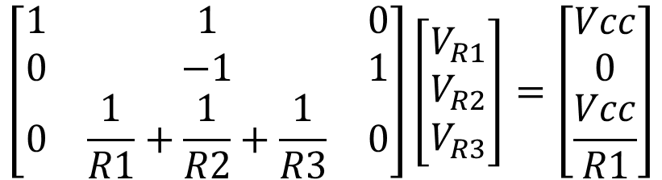




Uygulamalı Örnek
$9$Ω
$$12V$$
$$4\text{Ω}$$
$$12\text{Ω}$$
$$Vcc=12V$$
$$R1=9\text{Ω}$$
$$R2=4\text{Ω}$$
$$R3=12\text{Ω}$$
$$\left[\begin{matrix}1 & 1 & 0 \\ 0 & −1 & 1 \\ 0 & \frac{1}{R1}+\frac{1}{R2}+\frac{1}{R3} & 0\end{matrix}\right]\left[\begin{matrix}V_{R1} \\ V_{R2} \\ V_{R3}\end{matrix}\right]=\left[\begin{matrix}Vcc \\ 0 \\ \frac{Vcc}{R1}\end{matrix}\right]$$
$$x=A^{−1}y$$

Slide 10
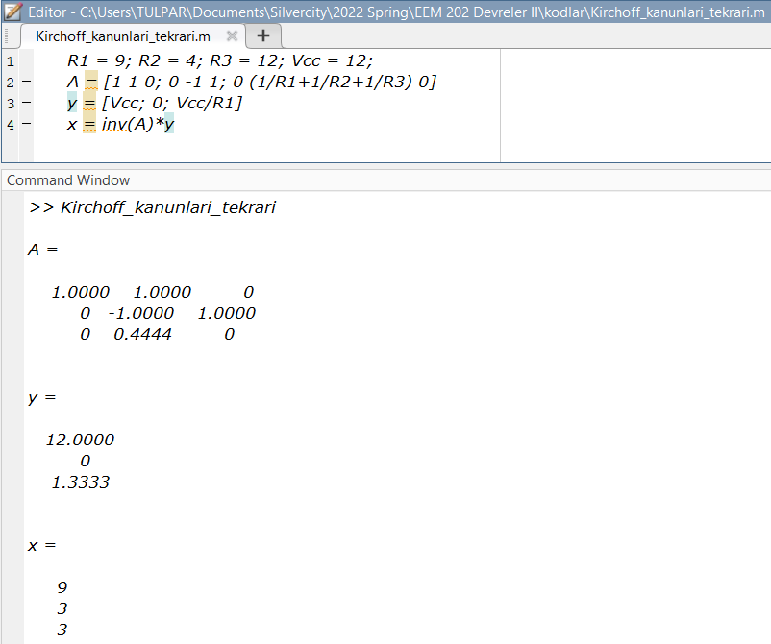
MATLAB’da Doğrusal Denklem Sistemini Çözelim
Let’s solve system of linear equations in MATLAB

Slide 11
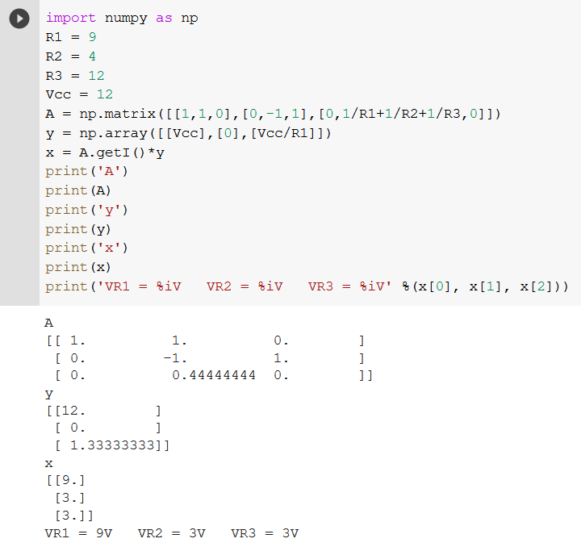
Google COLAB’da Python ile Doğrusal Denklem Sistemini Çözelim
Let’s solve system of linear equations in Google COLAB with Python

